Slide 1



Front-end

Slide 2




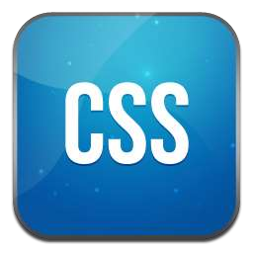

Front-end

Slide 3




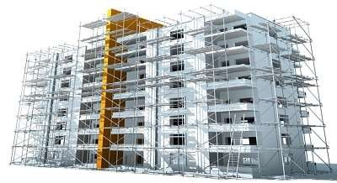
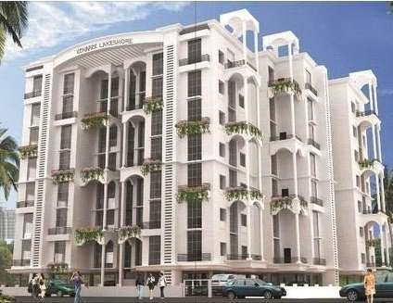

Three layers of web design:
Structure
HTML markup
Style
CSS
Behavior
JavaScript

Slide 4

HTML =
Hyper Text Markup Language

Slide 5

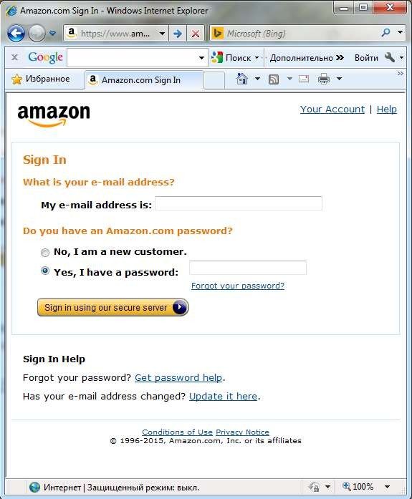

Do you imagine how this page would look like without HTML?

Slide 6

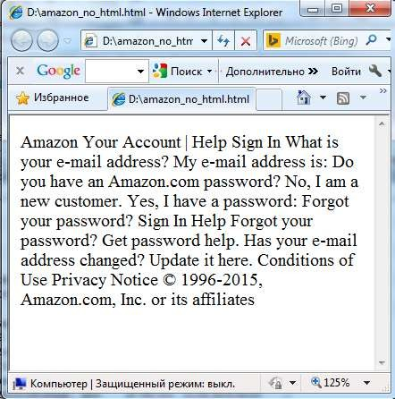

Looks ugly… Doesn’t it?

Slide 7

No HTML?
Without any markup to give your page content structure, the browser renders unformatted and unstyled text

Slide 8

HTML tags give
structure
and
meaning
to your content.

Slide 9

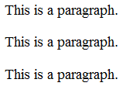
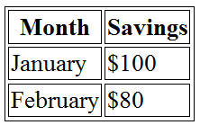
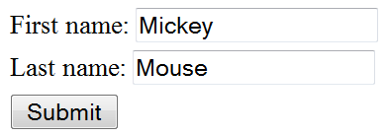

HTML Tags
<p></p> - to organize text into paragraphs
<table></table> - to display table
<form></form> - to define form for user input
<img></img> - to add image

Slide 10

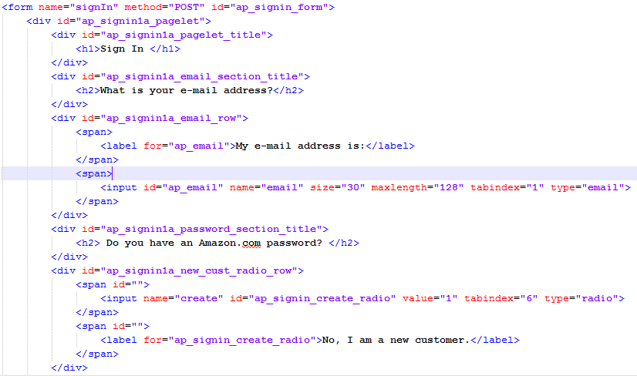
Lets add HTML tags to our page...
How will it look now?

Slide 11

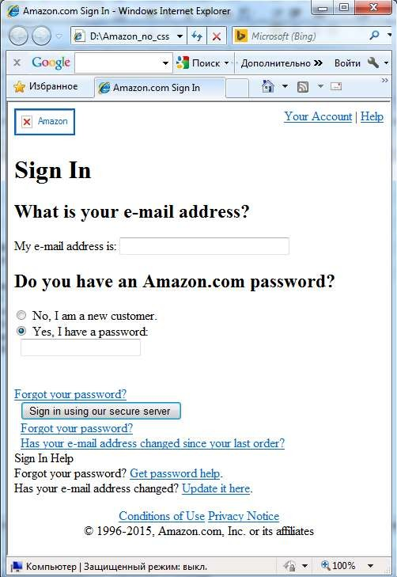

Looks better… But still not good…

Slide 12

HTML
Once page content is marked up with HTML tags, the browser applies default styles to the tags.
So now page is readable and have a clear hierarchy.

Slide 13
But what should we do to make the page look nice?
The answer is use CSS!

Slide 14
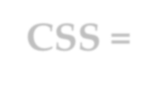
CSS =
Cascading Style Sheet

Slide 15

CSS
Set of rules defining how an html element will be “presented” in the browser.

Slide 16


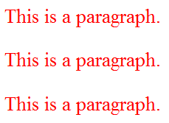
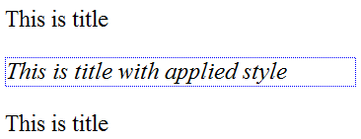
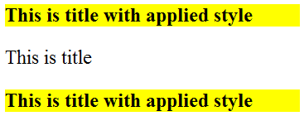
CSS Rules
p {
color: red;
}
#title {
font-style: italic; border: 1px dotted blue;
}
.title {
font-weight: bold; background: yellow;
}

Slide 17
Some things you can change with CSS
colors
font
font size
backgrounds
spacing
sizes
borders
positions (layout)

Slide 18



Some things you can’t
change with CSS
content
markup

Slide 19


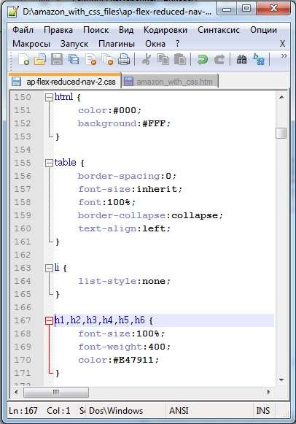
So now it’s time for styling!!!
Lets add some css rules to our example page.

Slide 20


How will it look now???

Slide 21
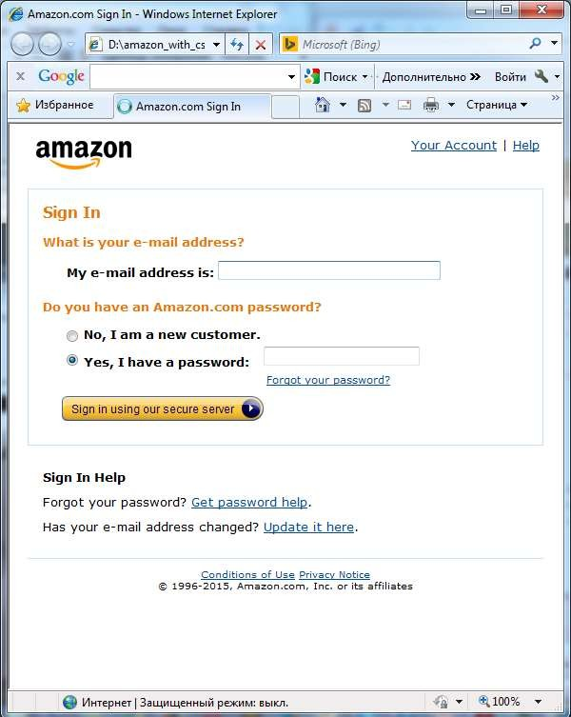

Looks perfect!

Slide 22


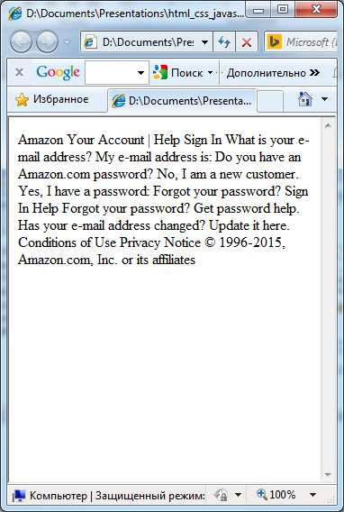
Text
+ HTML
+ CSS
= Web Page

Slide 23

Now time for actions!
JavaScript

Slide 24












JavaScript ≠ Java
(c) Jeremy Keith, web developer, 2009

Slide 25

JavaScript ≠ Java
JavaScript was not developed at Sun Microsystems, the home of Java.
JavaScript was developed at Netscape in 1995.
It was originally called LiveScript, but that name wasn't
confusing enough. ☹
Java was the buzzword in the days when LiveScript was created, so LiveScript was renamed into JavaScript in the hope of catching the media’s interest.
But from confusion came misunderstanding…

Slide 26
JavaScript ≠ Java
JavaScript is NOT a Java
It is NOT a light version of Java
It was NOT based on Java
It does NOT matter if you know Java

Slide 27



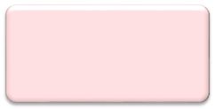
JavaScript
Classic JavaScript is a client-side language used to add interactivity to your web-pages
Web Browser
Web Page
JavaScript

Slide 28


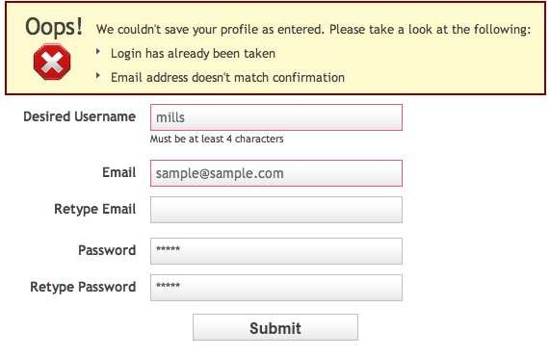
What we can do with JavaScript?
Validate values entered in the form fields

Slide 29
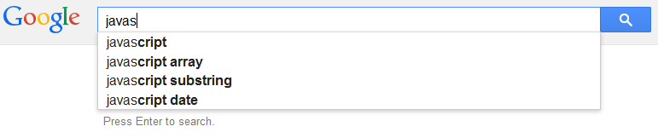
What we can do with JavaScript?
A search box can give you suggested results while you type, based on what you’ve entered

Slide 30
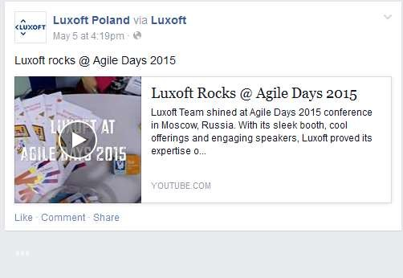
What we can do with JavaScript?
Load information automatically when it's needed

Slide 31
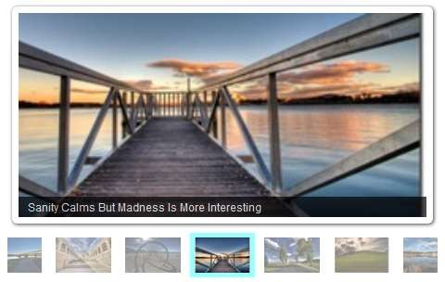
What we can do with JavaScript?
Create photo slideshow and control how long it takes to move from one image to the next and with what animation effect

Slide 32
What we can do with JavaScript?
And much much more…

Slide 33


JavaScript
At the beginning JavaScript was designed to manipulate web pages.
And it does that very well!
But nowadays its usage is much much wider: you can use it outside of web pages and the browser

